Slide 1
Rtos traffic light: prioritizing emergency vehicles and pedestrians
Team Members:
Jacob Wald
Erika Valle-Baird

Slide 2
CONTENTS
Concept
Requirements
Design
Testing
Implementation
Documentation
References
RTOS Traffic Light Prioritizing Emergency Vehicles & Pedestrians

Slide 3
CONCEPT
RTOS-Based Traffic Light Controller
Prioritizes:
Key Advantages:
Emergency Vehicle Preemption
Pedestrian Safety
Conflict-Free Signal Transitions
Deterministic Timing & Scheduling
Low cost
Low complexity
No AI / Cloud dependency
RTOS Traffic Light Prioritizing Emergency Vehicles & Pedestrians

Slide 4
Concept- Stakeholders
Stakeholder Groups:
Low-Resource Cities
Developers & Researchers
Smart City Planners
Emergency Response Systems
Unique About Our Project-
Low-Cost Embedded Solution
Deployable Without Smart Infrastructure
Deterministic & Safety-Critical Design
RTOS Traffic Light Prioritizing Emergency Vehicles & Pedestrians

Slide 5
Concept- Feasibility Study
City Infrastructure/Use
Rapidly growing cities
High instances of traffic accidents: drivers are not paying attention to emergency response vehicles and pedestrians
Emergency response vehicles proceed through red lights increasing accident risks
Feasible solution:
Change lights based on emergency response and pedestrian needs
RTOS Traffic Light Prioritizing Emergency Vehicles & Pedestrians

Slide 6
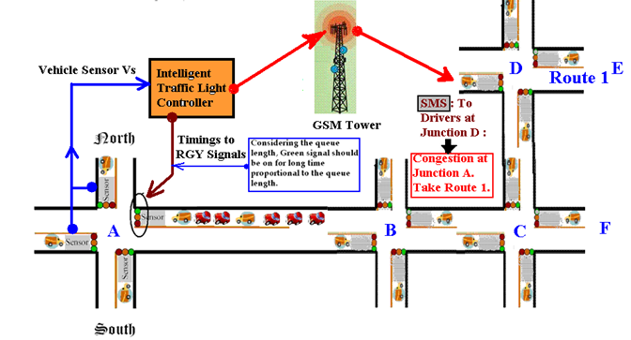
Concept- Literature survey
Research highlights newer Smart Cities:
Smart Cities are outfitted with expensive technology helping to mitigate accident rates
Studies show many cities cannot afford to implement this technology
Use of LiDAR for traffic lights can easily be hacked.
Figure 1: Intelligent Traffic Light Controller Concept Source: Adapted from [4]
RTOS Traffic Light Prioritizing Emergency Vehicles & Pedestrians

Slide 7
Requirements
Functional
Non-Functional
Timing & Sequencing Functionality
Pedestrian-Specific
Emergency Vehicle Handling
Normal Vehicle Handling
Display & Feedback
Reliability
Usability
Modularity
Performance
RTOS Traffic Light Prioritizing Emergency Vehicles & Pedestrians

Slide 8
Requirements- objective & need
System Objective:
Simulate an RTOS-based traffic
Dynamically respond to:
Emergency vehicles
Pedestrian requests
Enforce safe, deterministic signal behavior
Industry Need:
Reliable emergency vehicle prioritization
Safe pedestrian crossing in all conditions
Affordable alternatives to smart-city infrastructure
RTOS Traffic Light Prioritizing Emergency Vehicles & Pedestrians

Slide 9
design
RTOS Traffic Light Prioritizing Emergency Vehicles & Pedestrians

Slide 10
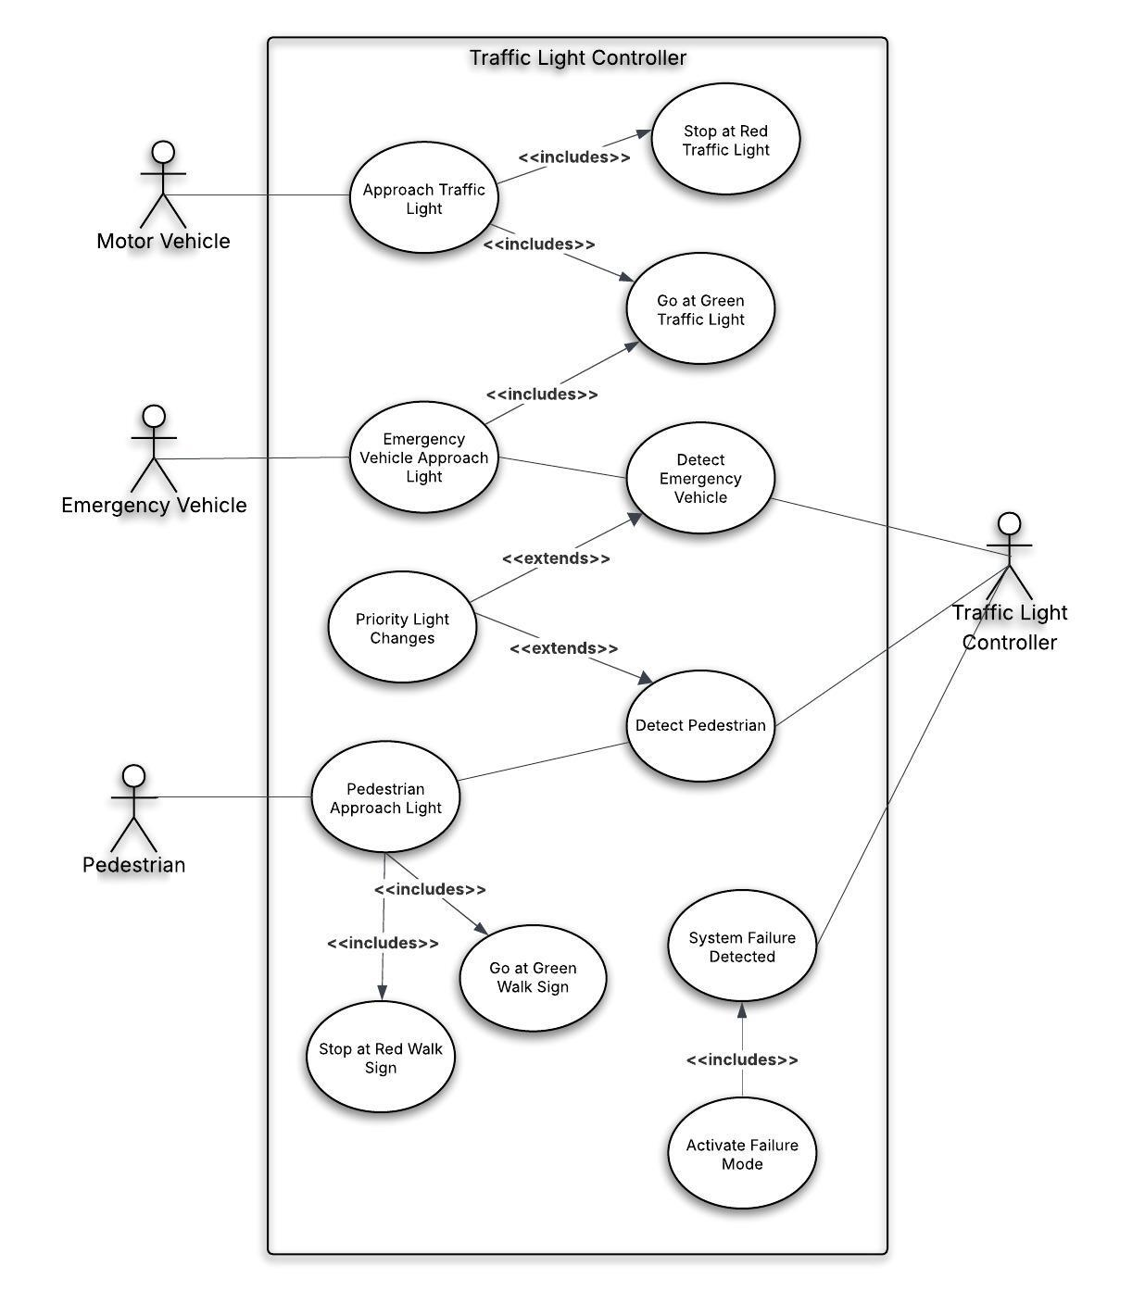
Design- Use-Case diagram
RTOS Traffic Light Prioritizing Emergency Vehicles & Pedestrians

Slide 11
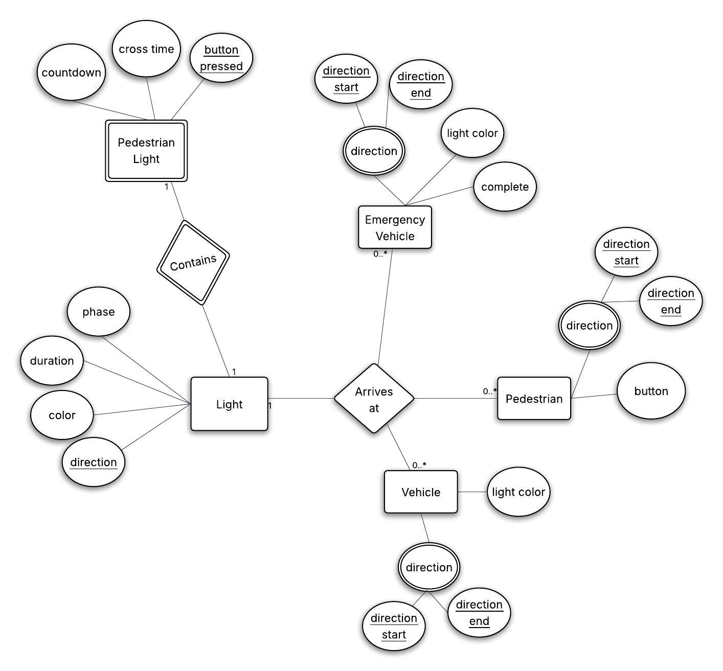
Design- Entity relationship diagram
RTOS Traffic Light Prioritizing Emergency Vehicles & Pedestrians

Slide 12
Testing
Black-Box
White-Box
Unit

Slide 13
TYPES OF Testing- Functional
Timing & Sequence
Pedestrian-Specific
Emergency Vehicle
Normal Vehicle
Display & Feedback
Test and confirm correct order of light phases, durations, and sequences.
Test and confirm pedestrian button press triggers correct controller WALK phase.
Test and confirm light changes in response to sensed emergency vehicle.
Test and confirm intersection clearance and stop rules.
Test and confirm user interface visuals occur when simulation begins running.
RTOS Traffic Light Prioritizing Emergency Vehicles & Pedestrians

Slide 14
TYPES OF Testing- Non-functional
Reliability
Usability
Modularity
Performance
Test that simulated traffic produces a consistent and deterministic result.
Test that system functions in Windows and/or Linux operating environment.
Test that system has clearly separated components.
Test traffic light changes occur within specified time parameters.
RTOS Traffic Light Prioritizing Emergency Vehicles & Pedestrians

Slide 15
Implementation
Goal: A Real-Time Scheduled Traffic System that-
Safely Coordinates
Vehicles
Pedestrians
Emergency Vehicles
Using
Priority-Driven Task Execution
State-Machine Control
RTOS System Used-
Periodic Tasks
Deterministic Timing
Different Priority Levels
RTOS Traffic Light Prioritizing Emergency Vehicles & Pedestrians

Slide 16
Implementation
Simulated Real-Time Operating System
Scheduler executes periodic tasks based on timing and priority
Preemptive Priority Scheduling
Ensures safety through priority enforcement
Finite State Machine:
Controls traffic signal behavior
System Clock:
Fixed Time-Step Simulation
RTOS Traffic Light Prioritizing Emergency Vehicles & Pedestrians

Slide 17
Implementation
RTOS Scheduling Model:
Normal traffic light cycles
Pedestrian crossings (with safety timing)
Emergency vehicle priority
Tasks:
Task | Priority | Period | Description
Traffic Control | High | 0.05s | Updates Signal States
Vehicle System | Medium | 0.02s | Moves & Spawns Vehicles
Background | Low | 0.10s | Idle
Behavior:
Tasks accumulate time → run when ready
Scheduler runs highest priority first
Simulates preemptive embedded system behavior
RTOS Traffic Light Prioritizing Emergency Vehicles & Pedestrians

Slide 18
Implementation
FINITE STATE MACHINE
Control Functions
Communication Mechanisms:
Synchronous
Asynchronous
Traffic Controller Handles:
Manages Signal Phase & System State
Phase transitions
Timing logic
Interrupt-like requests (emergency/pedestrian)
RTOS Traffic Light Prioritizing Emergency Vehicles & Pedestrians

Slide 19
Implementation
System Clock: Fixed Time-Step Simulation:
Periodic Signal, generated by a task/timer.
Simulated timer interrupts every 10 ms like an embedded microcontroller & real RTOS tick.
This Guarantees:
Deterministic Timing
Pedestrian crossing is always equal to or greater than 20s
Emergency vehicles are handled immediately
Purpose: Confirms the scheduler is functioning, interrupts are active, & no tasks are deadlocked.
RTOS Traffic Light Prioritizing Emergency Vehicles & Pedestrians

Slide 20
Implementation
Tasks Represented like Real Embedded Systems
Subsystem Control Tasks Simulated/Represented by:
Traffic Control Task
Vehicle System Task
Background Task
1. Traffic Control Task: Traffic Controller firmware task.
Traffic Controller Manages:
Traffic Lights
Pedestrian Phase
Emergency Overrides
2. Vehicle System Task: Simulated sensor & actuator update loop.
Vehicle System Manages:
Positions
Movement Rules
Collison Spacing
3. Background Task: Idle Tasks in RTOS
Background Task Manges:
What can run when nothing else needs the CPU
RTOS Traffic Light Prioritizing Emergency Vehicles & Pedestrians

Slide 21
Implementation
Preemptive Priority Scheduling: Simulates preemptive embedded system behavior
Purpose: Preemptive RTOS behavior when dealing with multiple tasks ready at the same time. New tasks that arrive with a higher priority preempt currently running task.
Priority-based Task Execution:
HIGH: Traffic Control
MEDIUM: Vehicle Systems
LOW: Background
RTOS Traffic Light Prioritizing Emergency Vehicles & Pedestrians

Slide 22
Implementation
Guaranteed Safety: Priority Enforcement
Purpose: RTOS Resource Protection and Real-Time Constraint Handling.
Used for: Emergency Vehicles and Pedestrians.
Priority-based Task Execution: Priority Safety
Emergency > Pedestrian > Normal Traffic
Emergency Vehicles: Real-Time Constraint Handling done by
Forcing system into a safe state (ALL RED = EMERGENCY)
Immediately Overriding of all other tasks.
Pedestrians: RTOS Resource Protection
Done by ensuring Deterministic Timing & preventing reentrancy bugs
SAFETY GUARANTEES-
No conflicting green lights
Controlled entry/exit during special phases
RTOS Traffic Light Prioritizing Emergency Vehicles & Pedestrians

Slide 23
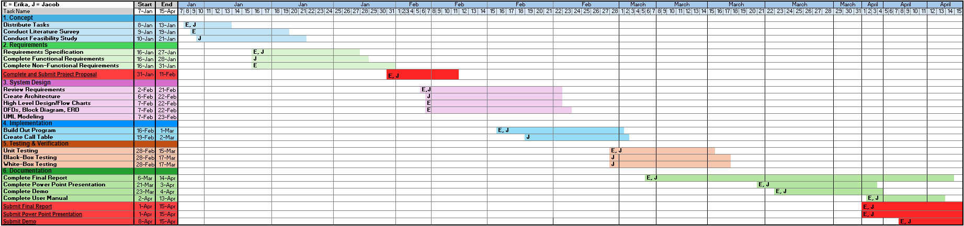
Documentation
RTOS Traffic Light Prioritizing Emergency Vehicles & Pedestrians
Notes:
This Gantt chart outlines the project timeline and how we structured our development process.
We followed a waterfall-style approach, progressing through phases like requirements, design, implementation, testing, and documentation.
Each phase had clearly defined tasks and timelines, allowing us to stay organized and ensure steady progress throughout the project.
Overall, this helped us manage workload, track milestones, and complete the project in a structured and predictable manner.

Slide 24
References
[1] S. S. Chavan, R. S. Deshpande and J. G. Rana, "Design of Intelligent Traffic Light Controller Using Embedded System," 2009 Second International Conference on Emerging Trends in Engineering & Technology, Nagpur, India, 2009, pp. 1086-1091, doi: 10.1109/ICETET.2009.76.
[2] S. Chiu and S. Chand, "Adaptive Traffic Signal Control Using Fuzzy Logic," 1993 IEEE International Conference on Fuzzy Systems, San Francisco, CA, USA, 1993, pp. 1371-1376.
[3] Z. Bundalo, M. Veljko, D. Bundalo, G. Kuzmić, M. Sajić, and A. Ramakić, "Energy Efficient Embedded Systems for LED Lighting Control in Traffic," 8th Mediterranean Conference on Embedded Computing (MECO), Budva, Montenegro, 2019, pp. 1-4, doi: 10.1109/MECO.2019.8760048.
[4] L. Cai, Z. Li, Y. Zhong, P. Lin and F. Zhang, "Design and Optimization of Intelligent Traffic Light Based on STM32 Microcontroller," in Proceedings of the 2024 International Symposium on Integrated Circuit Design and Integrated Systems (ICDIS 2024), Xiamen, China, Nov. 22-24, 2024, ACM, New York, NY, USA, 6 pages.
[5] H. Kulhandjian, W. Greives, and M. Kulhandjian, "Smart Traffic Light Controller using Visible Light Communications," IEEE Vehicle Power and Propulsion Conference (VPPC), Merced, CA, USA, 2022, pp. 1-6, doi: 10.1109/VPPC55846.2022.10003305.
RTOS Traffic Light Prioritizing Emergency Vehicles & Pedestrians

Slide 25
References
[6] D. Baskar, S. Pragadeswaran, N. Ragupathi, U. S. Praveen, S. Preethi, and S. R. Vishnu Kumar, "IoT-based Smart Traffic Management System," in 2025 7th International Conference on Inventive Material Science and Applications (ICIMA), Namakkal, India, May 2025, doi: 10.1109/ICIMA64861.2025.11074196.
[7] L. Wu, R. Zhang, R. Zhou and D. Wu, "An edge computing based data detection scheme for traffic light at intersections," Computer Communications, vol. 176, pp. 91-98, 2021.
[8] M. M. Elkhatib, A. I. Adwan, A. S. Alsamna and A. M. Abu-Hudrouss, "Smart Traffic Lights using Image Processing Algorithms," 2019 IEEE 7th Palestinian International Conference on Electrical and Computer Engineering (PICECE), Gaza, Palestine, 2019, pp. 1-6, doi: 10.1109/PICECE.2019.8747225.
[9] I. Gokasar and A. Timurogullari, "Real-Time Prediction of Traffic Density with Deep Learning Using Computer Vision and Traffic Event Information," in 2021 International Conference on Innovations in Intelligent Systems and Applications (INISTA), Kocaeli, Turkey, Aug. 2021, doi: 10.1109/INISTA52262.2021.9548434.
[10] H. Wei, G. Zheng, H. Yao and Z. Li, "IntelliLight: A Reinforcement Learning Approach for Intelligent Traffic Light Control," in Proceedings of the 24th ACM SIGKDD International Conference on Knowledge Discovery & Data Mining (KDD '18), London, United Kingdom, Aug. 19-23, 2018, ACM, New York, NY, USA, 10 pages.
RTOS Traffic Light Prioritizing Emergency Vehicles & Pedestrians

Slide 26
References
[11] T. Chu, J. Wang, L. Codecà and Z. Li, "Multi-Agent Deep Reinforcement Learning for Large-scale Traffic Signal Control," arXiv preprint arXiv:1903.04527, 2019.
[12] B. Muyombo, H. Vadapalli, "Enhancing Urban Traffic Flow: An AI-Driven Traffic Light Management System", Procedia Computer Science, Volume 270, June 2025, Pages 3848-3859, ISSN 1877-0509, https://doi.org/10.1016/j.procs.2025.09.510.
[13] R. M. Khaleefah, "An Intelligent Traffic Control System using Edge-Cloud Computing and Deep Learning for Smart Cities," International Journal of Engineering Research & Technology (IJERT), vol. 14, no. 07, July 2025, doi: 10.17577/IJERTV14IS070169.
[14] M. Raza, M. Kazmi, H. M. Kidwai, H. R. Khan, S. A. Qazi, K. Arshad and K. Assaleh, "An Edge-Deployed Real-Time Adaptive Traffic Light Control System Using YOLO-Based Vehicle Detection and PCE-Aware Density Estimation," IEEE Access, vol. 13, 2025.
RTOS Traffic Light Prioritizing Emergency Vehicles & Pedestrians

Slide 27
THANK YOU
RTOS Traffic Light Prioritizing Emergency Vehicles & Pedestrians

Slide 28
A demonstration of our RTOS traffic light system that prioritizes pedestrians and emergency vehicles can be found at: https://youtu.be/w7sQMiFTz9Q
https://youtu.be/w7sQMiFTz9Q.

